Slide 1
Analysis of Placement Data

Slide 2
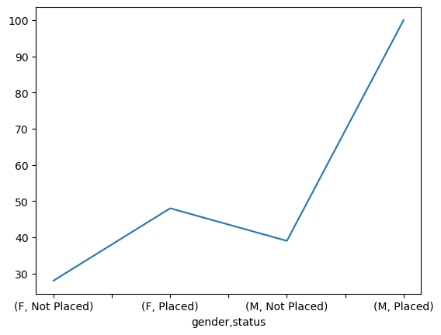
Effect of Gender on Placements
From the above plot, we can say that Male students are offered a slightly greater salary than females on average.

Slide 3
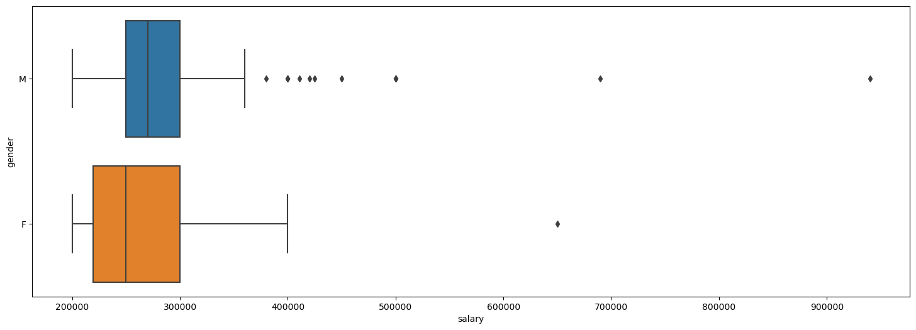
Effect of Gender on Salary
Male students have a comparatively higher placement. Male students are getting high CTC jobs

Slide 4
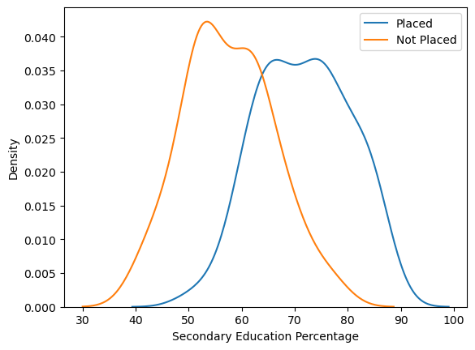
Does Secondary Education affect placements?
We clearly see from the plot above that: All students with Secondary Education Percentage above 90% are placed, All students with Secondary Education Percentage below 50% are not-placed, Students with good Secondary Education Percentage are placed on average.

Slide 5
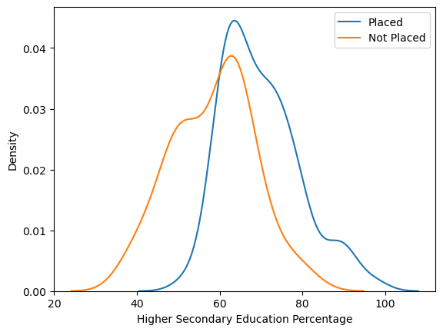
Does Higher Secondary School affect Placements?
We can see that Overlap here too. More placements for percentage above 65%A straight drop below 60 in placements -> Percentage must be at least 60 for a chance of being placed Education Board again doesn’t affect placement status much.

Slide 6
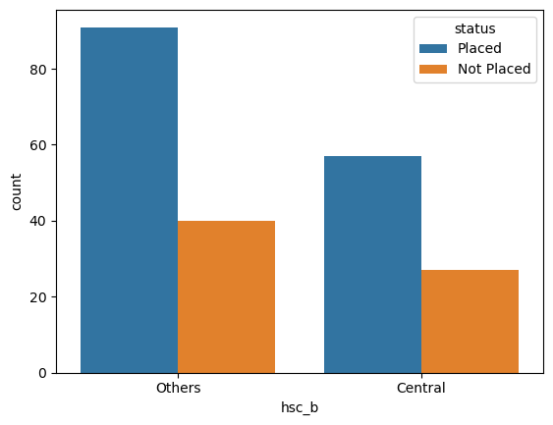
Effect of Higher Secondary board on Placements
We can See there no such any pattern

Slide 7
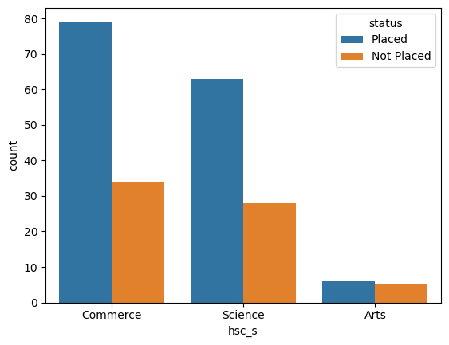
Does Higher Secondary Stream effect Placements?
We can see those very fewer students with Arts specialization. Around 2:1 unplaced ratio for both Science and Commerce students.

Slide 8
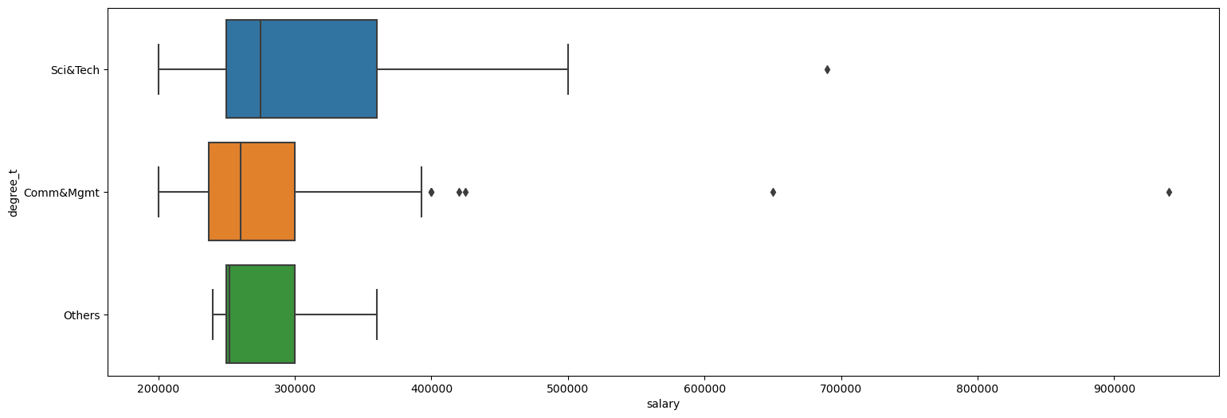
What’s the effect of Specialization on Placements?
Science&Tech students getting more salary on average, Management students are getting more highly paid dream jobs

Slide 9
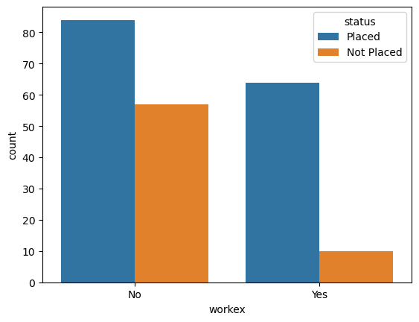
Does work Experience affect placements?
We can see that from both the plots that Very few students with work experience not getting placed

Slide 10
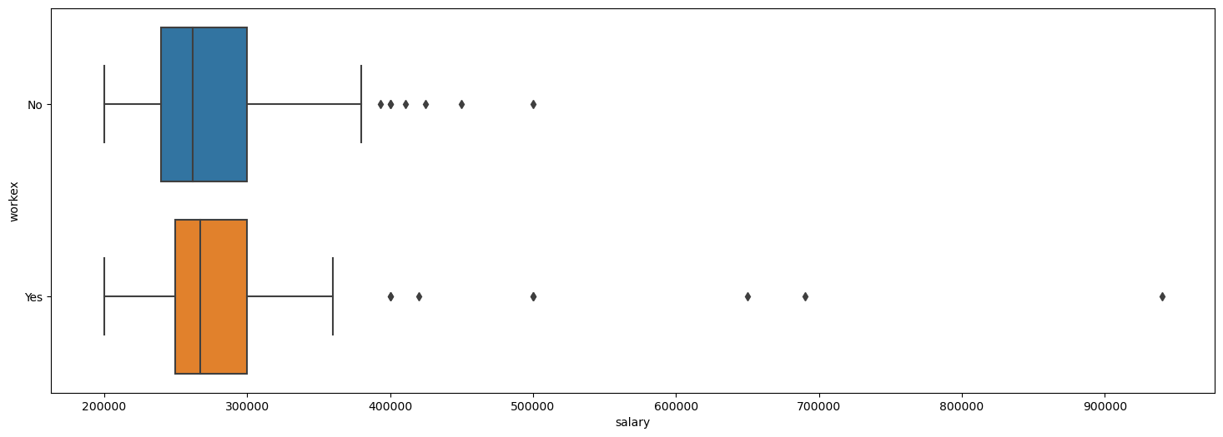
Effect of Work Experience on Salary
Outliers (High salary than average) on both end but students with experience getting dream jobs, Average salary as well as base salary high for students with work experience.

Slide 11
Thank You
Github link-
Sagar Kumar Mishra –sagar20mishra@gmail.com
Shivam Kumar Chaubey
shivamc36@gmail.com
Shivam Kumar
sk8612181@gmail.com

